Slide 1
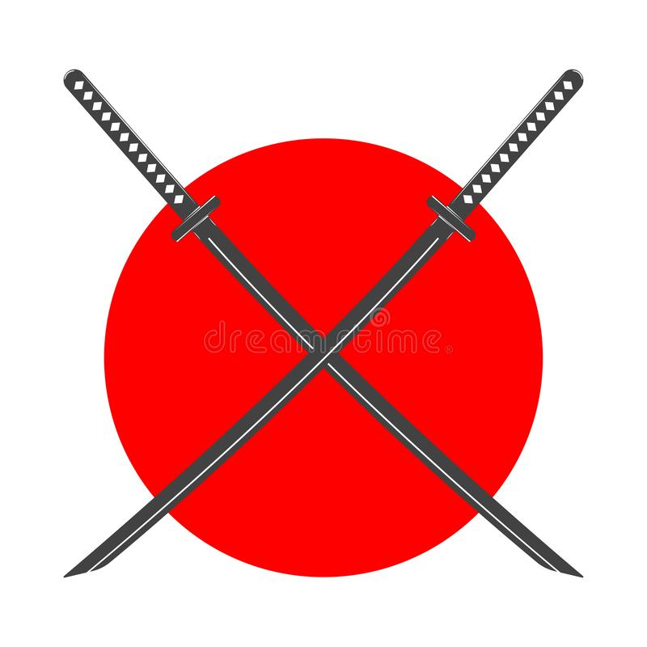
Kaizen for Managers
“Aim: Applying Kaizen Principles in Management: How to Foster a Culture of Continuous Improvement and Empower Your Team for Long-Term Success"

Slide 2

Objectives:
Explain Kaizen and The Kaizen Mindset
Providing You With The Tools Of Implementing Kaizen Principles In Your Organisation and Sustaining The Culture Of Kaizen

Slide 3

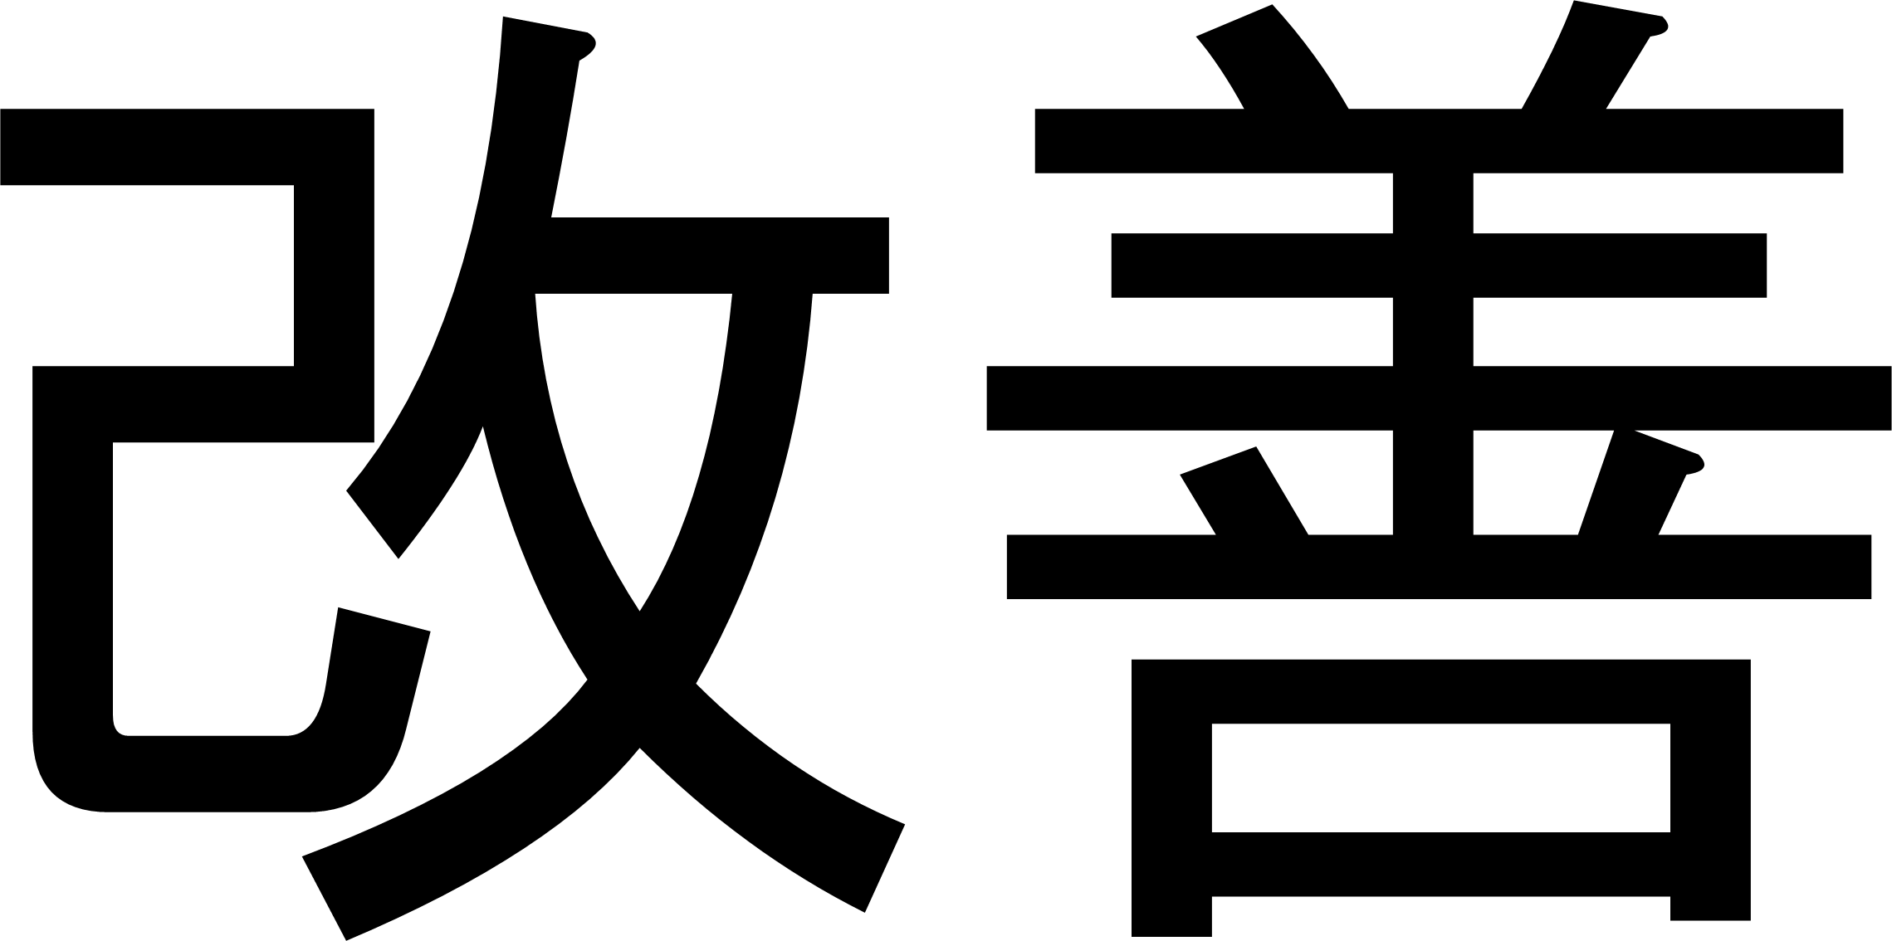

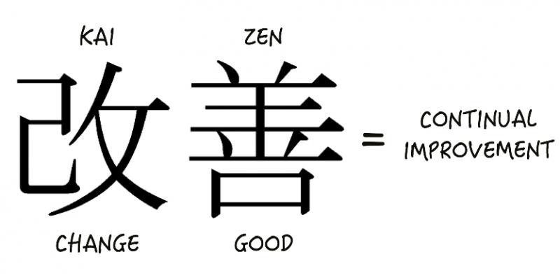
Does any one know the meaning of Kaizen in Japanese?
=

Slide 4
The Kaizen Mindset
Philosophy of continuous improvement
Emphasizes small, incremental changes over time
Focus on ongoing process of improvement

Slide 5

The Kaizen Mindset
Philosophy of continuous improvement
Emphasizes small, incremental changes over time
Focus on ongoing process of improvement

Slide 6

Empowering Your Team
Give your team ownership of work
Creating a collaborative work environment
Empowerment leads to higher engagement and better morale

Slide 7
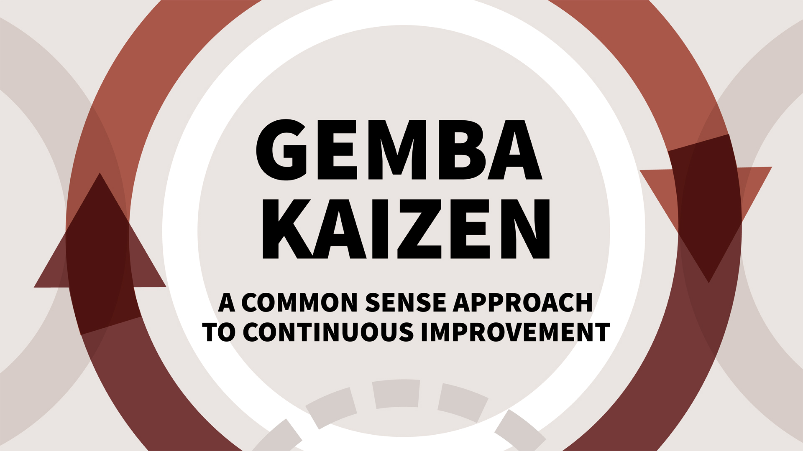
The Value of Gemba
- Going to the place where work is being done
- Observing work first hand to identify areas for improvement
- Key aspect of Japanese management

Slide 8

Implementing Kaizen Principles in Your Organization
Create culture of Kaizen
1
Start with small, incremental changes
2
3
Set clear goals and objectives
4
Provide regular feedback and be open to feedback

Slide 9

Sustaining the
Of Kaizen
- Ongoing commitment and effort
- Celebrate successes and recognize achievements
- Provide ongoing training and development opportunities

Slide 10


Slide 11


